Slide 1
Avian mycoplasmosis
These prokaryotes are characterized by their
very small size, small genome, and complete absence of cell walls; they
are bound by a plasma membrane only

Slide 2
The route of infection is via the conjunctiva or upper respiratory tract with an incubation period of 6-10 days.
“
fried egg” type of colony morphology,
resistance to antibiotics that affect cell wall synthesis,
complex nutritional requirements

Slide 3
Mycoplasma gallisepticum infection, M.G., Chronic respiratory disease

Slide 4
Mycoplasma gallisepticum causes :
A -Chronic Respiratory Disease (CRD):In chickens.
B – Infectious Sinusitis: In Turkeys.
Most outbreaks are in broiler chickens older than 4 weeks. The course of the disease is more severe during the winter and in cases of associated infections.
Predisposing factors include stress, bad management and viral respiratory infections.

Slide 5
The route of infection is via the conjunctiva or upper respiratory tract with an incubation period of 6-10 days.
A vertical transmission .
Horizontal transmission via airborne route, by coughing or contaminated food , water and environment.
Recovered birds remain infected for life.

Slide 6
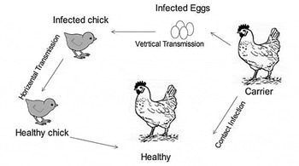

Slide 7
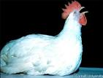
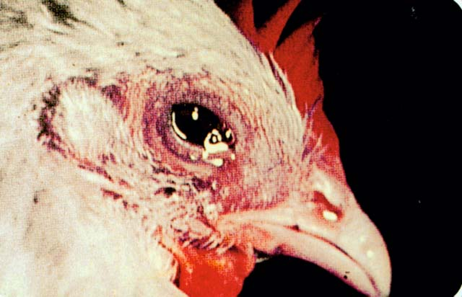
Clinical signs:
most characteristic signs in adult are tracheal rales, coughing, decreased egg production.
Gasping .
Nasal and ocular discharge.

Slide 8
facial skin Edema

Slide 9
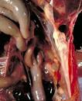
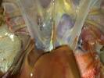
Most common gross finding is airsacculitis , the air sacs being filled with fibrinous caseous exudates.

Slide 10
2-Mycoplasma meleagridis
Causes:
Airsacculitis in Turkey Poults(Immature Turkey).
Egg transmission and embryo infection reduces hatchability (due to late embryo mortality), poult quality, and growth rate. Only mild respiratory signs may be seen despite high rates of airsacculitis in poults from infected hens

Slide 11
Hatched poults may have airsacculitis with variable degrees of thickening, turbidity, foamy yellow exudate, and caseous flecks

Slide 12
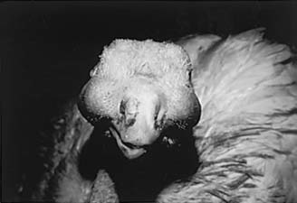
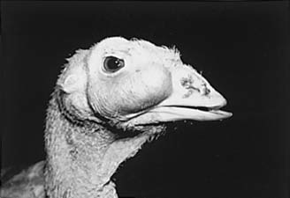
Turkey with advanced case of infectious sinusitis.

Slide 13
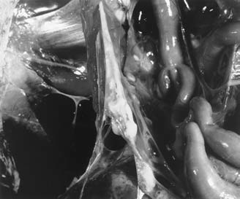
Airsacculitis.

Slide 14
3.Mycoplasma synoviae
Infection with Mycoplasma synoviae may be seen in chickens and turkeys in association with synovitis and/or airsacculitis.
Transovarian transmission.
Horizontal route via the respiratory tract is also possible.
Young chickens at the age of 4-12 weeks are susceptible.

Slide 15
Signs
Depression.
Inappetance.
Ruffled feathers.
Lameness.
Swelling of hocks, shanks and feet (sometimes severe and bilaterally asymmetrical).
Faeces may be green in acute infections.
Effects on egg production appear to be minor under good management.

Slide 16
Post-mortem lesions
Joints and tendon sheaths have viscid grey to yellow exudate.
Swollen liver, spleen and kidney have been seen in the past but are not common now.
Green liver.
Exudate becomes caseous later.
Sternal bursitis.
Airsacculitis - usually in heavy broilers

Slide 17
Swelling joints due to mycoplasma infection

Slide 18
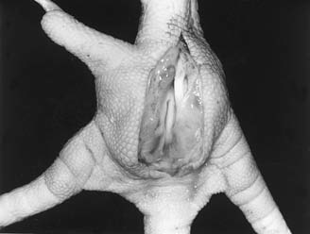
Incised swollen foot pad with purulent exudates.

Slide 19
Diagnosis
History.
Signs.
Lesion.
Serology: used routinely, Elisa in some countries - PCR and/or culture used to confirm.

Slide 20
Treatment :
1- Tetracycline.
2- Tylosin is the drug of choice

